Slide 1


What is Quantum Computing?
Priya Angara, Ulrike Stege

Slide 2

Frequently Asked Questions
Is it real?
Google just announced Quantum Supremacy. What does that mean?
Are Qubits in multiple states at once? How can that be possible?
Is security in our society going to break down?
How does the cat fit in to quantum computing?
Notes:
https://www.rspcasa.org.au/wp-content/uploads/2019/01/Adopt-a-cat-or-kitten-from-RSPCA.jpg

Slide 3
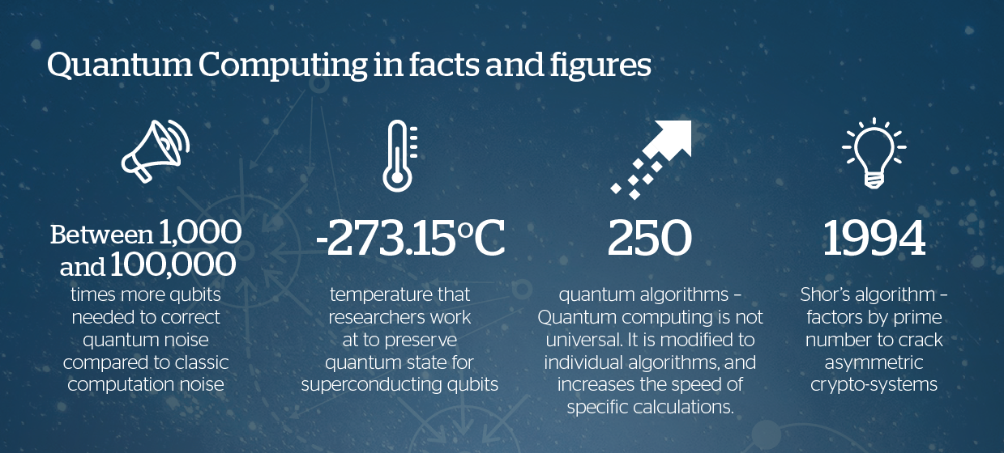
https://atos.net/en/insights-and-innovation/quantum-computing

Slide 4
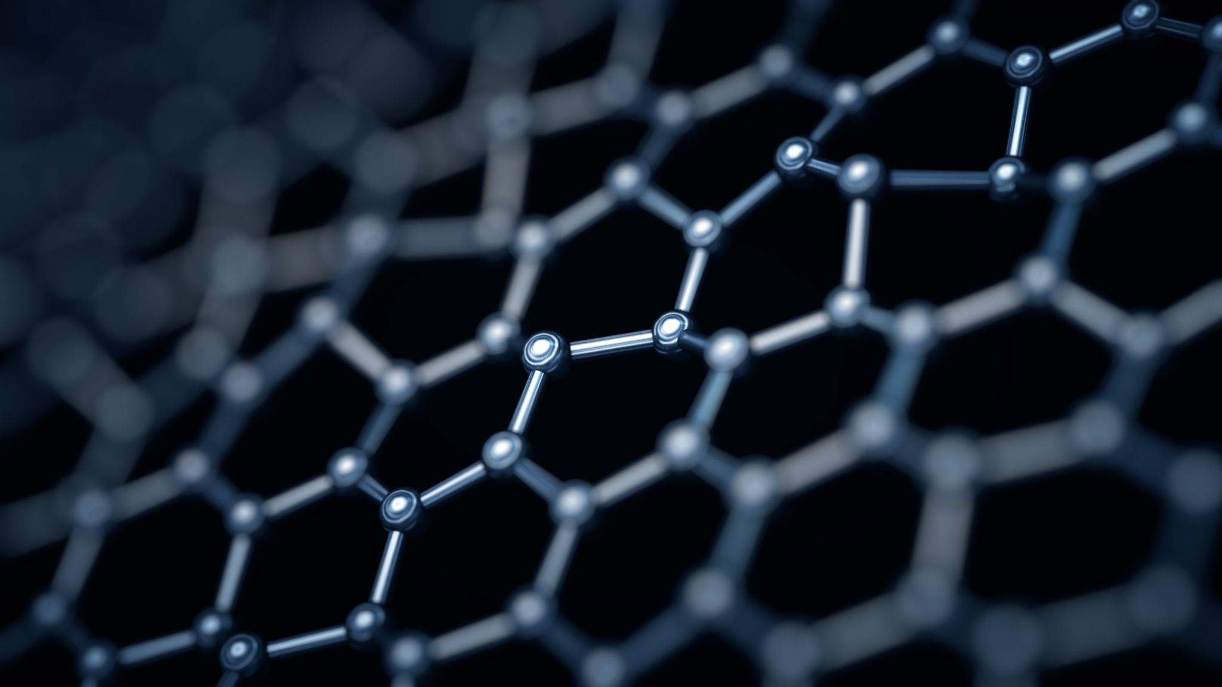
Quantum Physics

Slide 5
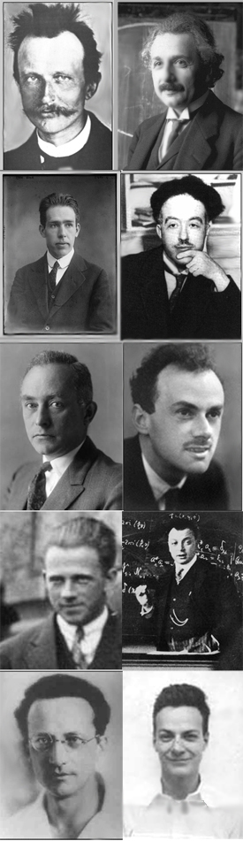
10 influential figures in the history of quantum mechanics. Left to right: Max Planck, Albert Einstein, Niels Bohr, Louis de Broglie, Max Born, Paul Dirac, Werner Heisenberg, Wolfgang Pauli, Erwin Schrödinger, Richard Feynman.
https://en.wikipedia.org/wiki/History_of_quantum_mechanics

Slide 6

Zooming in
Large scale = predictable
Nano scale = ????
Notes:
https://vimeo.com/355005914

Slide 7
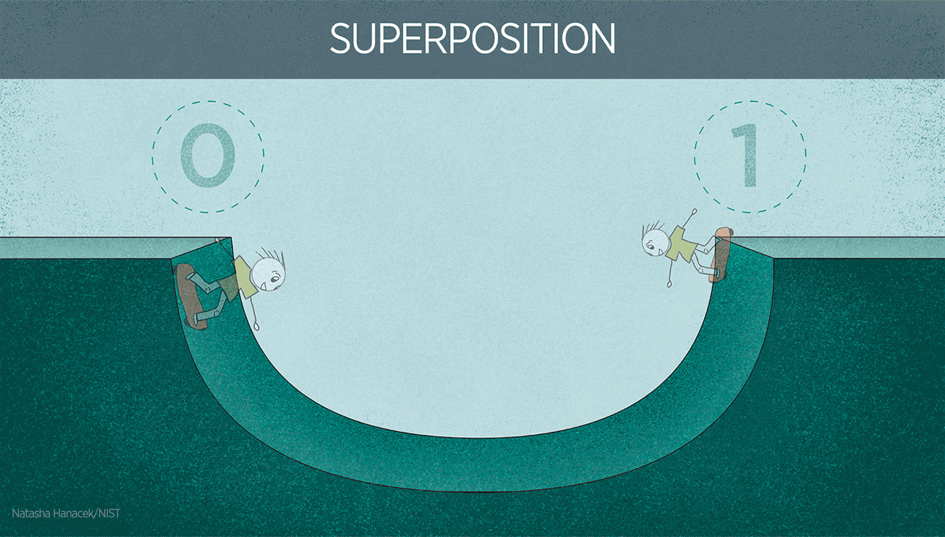
In the ordinary classical world, a skateboarder could be in only one location or position at a time, such as the left side of the ramp (which could represent a data value of 0) or the right side (representing a 1). But if a skateboarder could behave like a quantum object (such as an atom), he or she could be in a “superposition” of 0 and 1, effectively existing in both places at the same time.
Notes:
https://www.nist.gov/image/superpositiongif

Slide 8
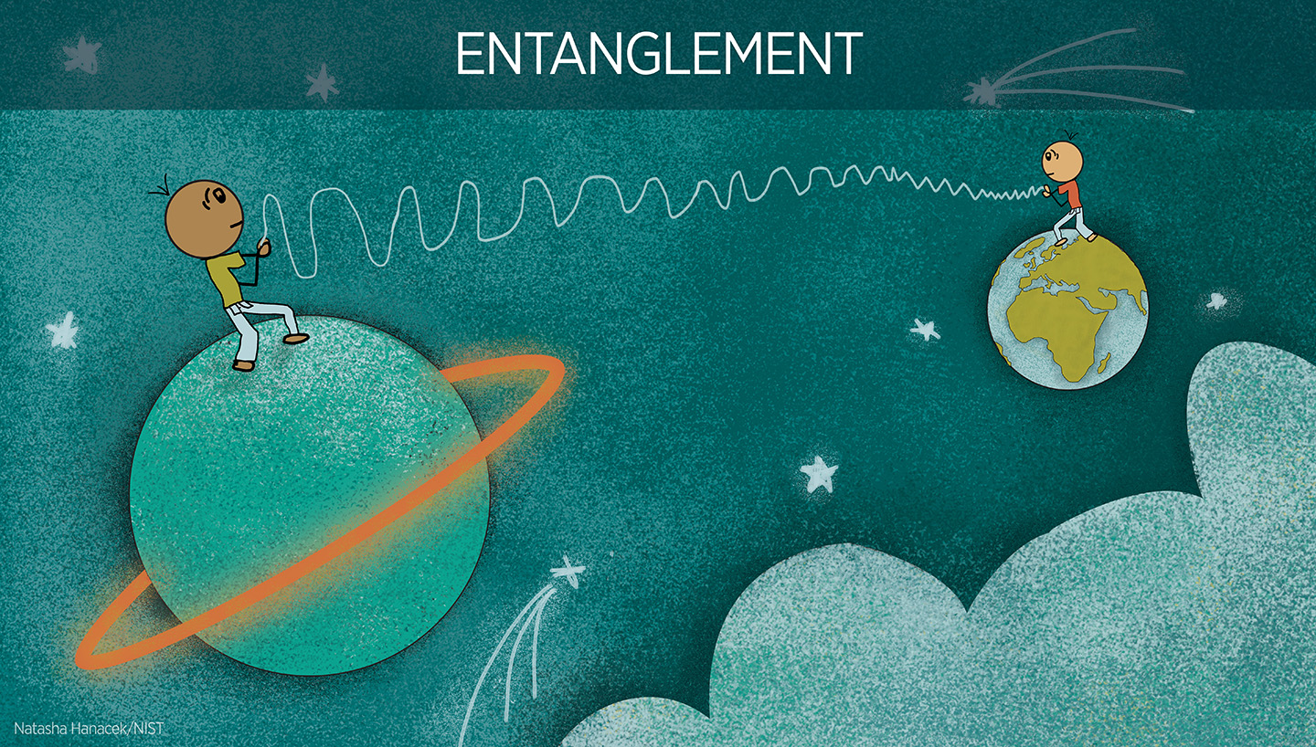
In the quantum phenomenon known as entanglement, the properties of two particles are intertwined even if they are separated by great distances from each other.
Notes:
https://www.nist.gov/image/entanglementrevjpg

Slide 9
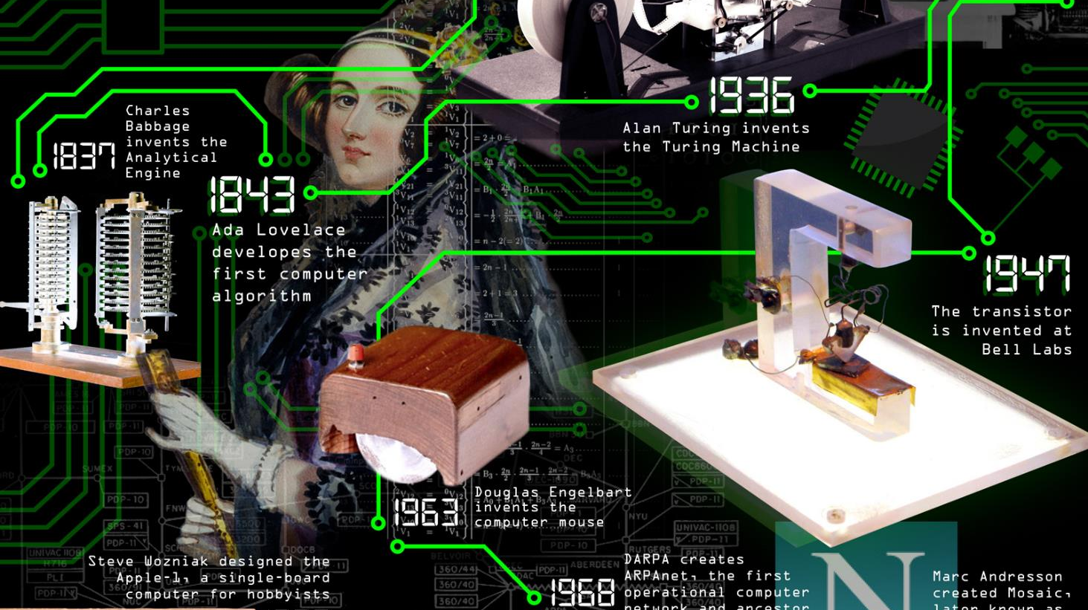
Computer Science
Notes:
https://www.worldsciencefestival.com/infographics/a_history_of_computer_science/

Slide 10

Computer Science

Slide 11
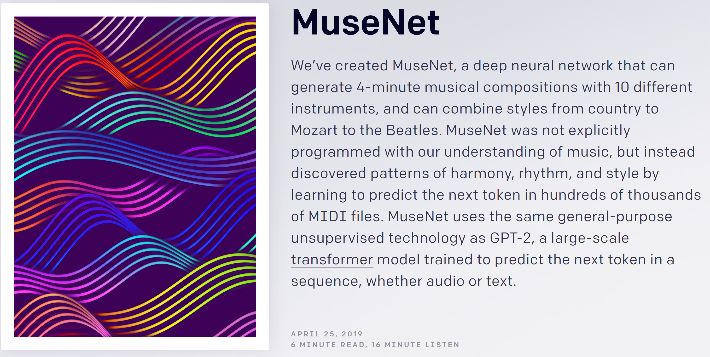
https://openai.com/blog/musenet/

Slide 12
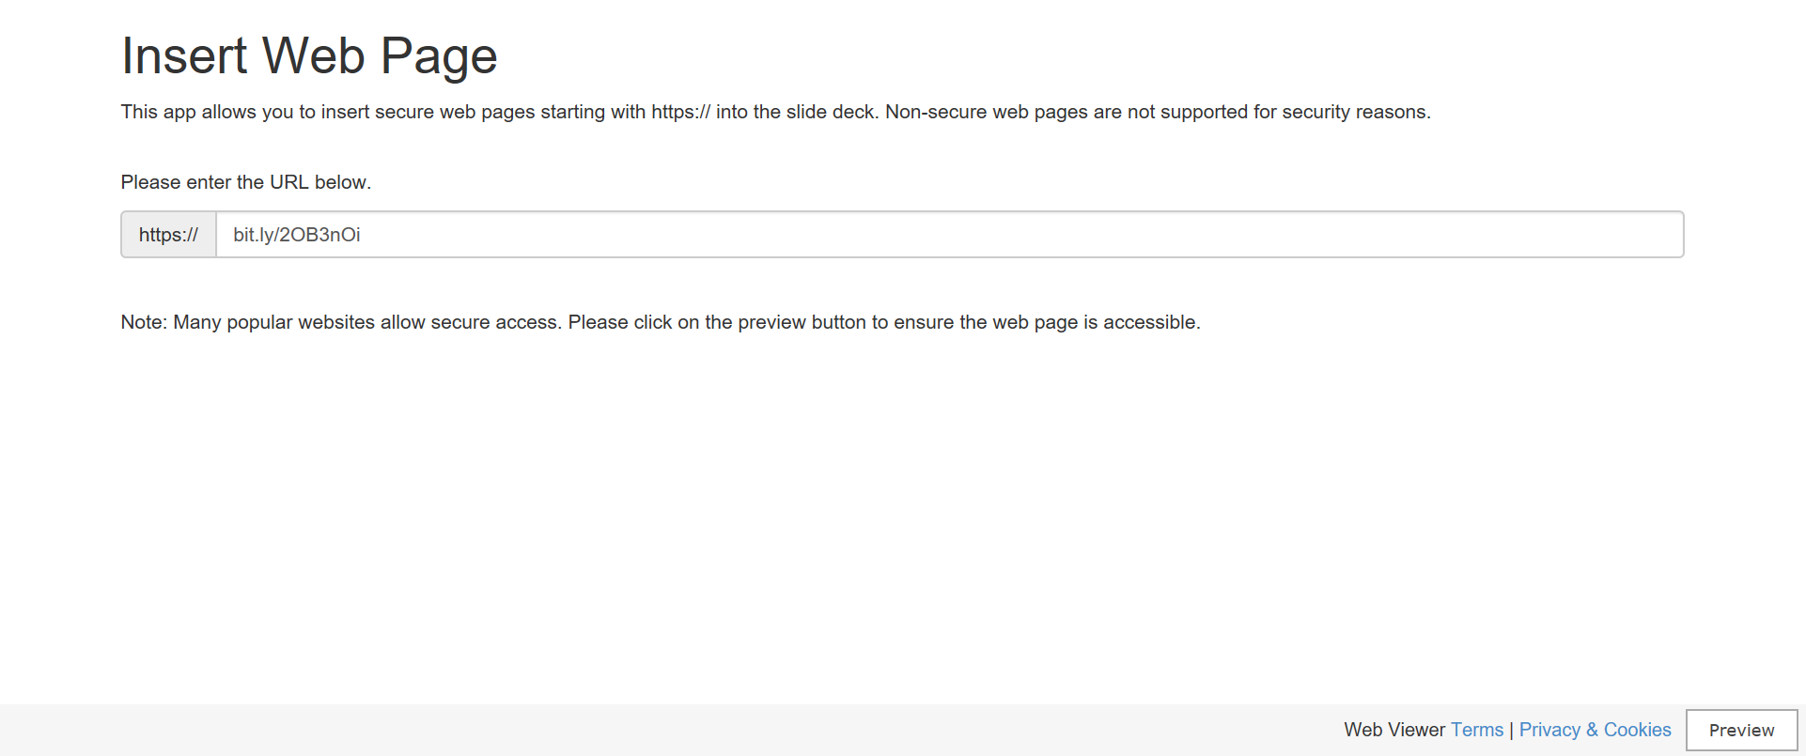
Prime Factorization

Slide 13
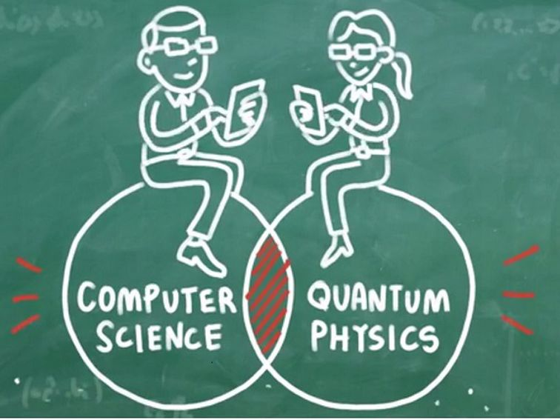
Notes:
https://news.microsoft.com/stories/stationq/

Slide 14
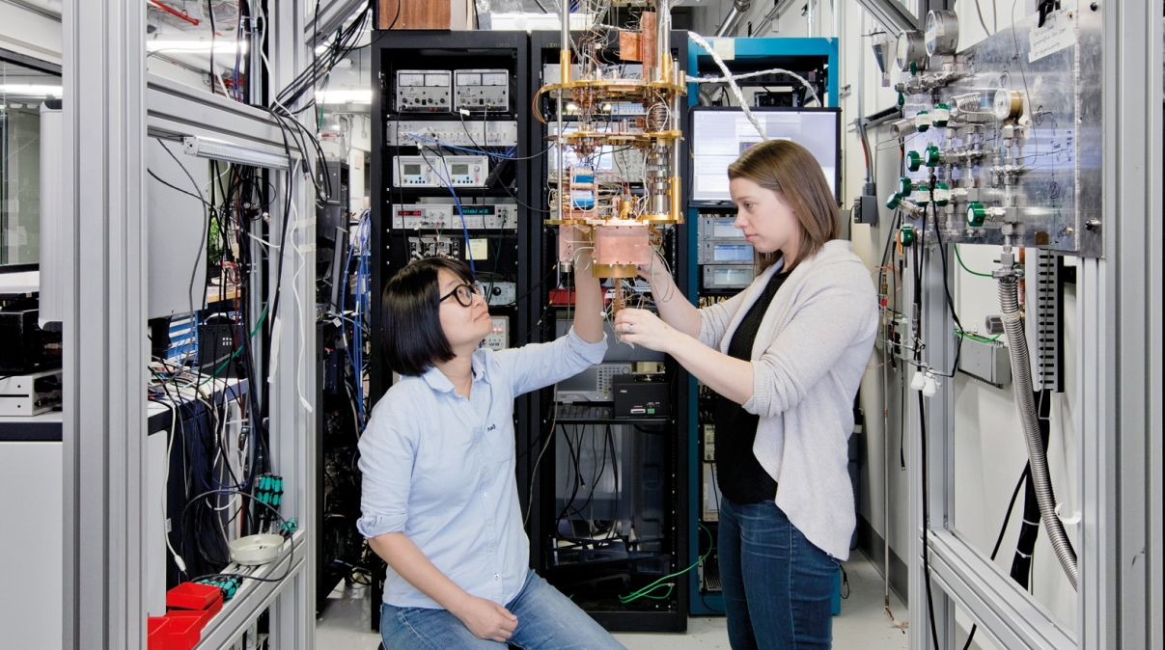
Quantum Computing!
IBM Quantum Computing Scientists Hanhee Paik (left) and Sarah Sheldon (right) examine the hardware inside an open dilution fridge at the IBM Q Lab at IBM’s T. J. Watson Research Center in Yorktown, NY.
Notes:
IBM Quantum Computing Scientists Hanhee Paik (left) and Sarah Sheldon (right) examine the hardware inside an open dilution fridge at the IBM Q Lab at IBM’s T. J. Watson Research Center in Yorktown, NY.

Slide 15
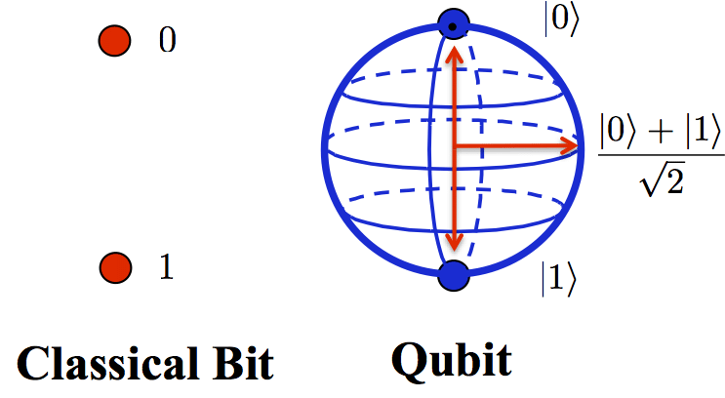
Qubits

Slide 16
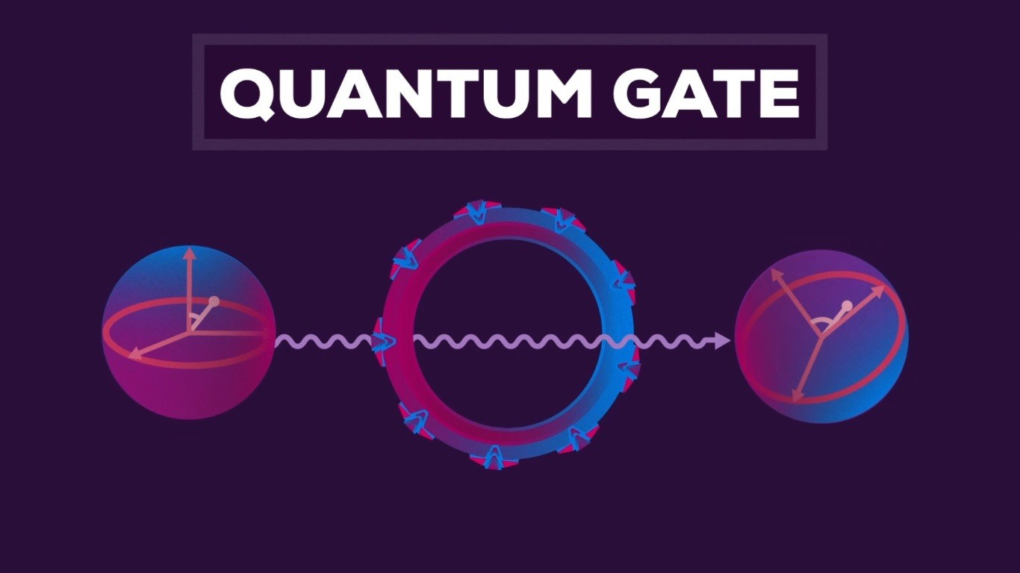
Notes:
https://www.popularmechanics.com/technology/a18480/what-is-quantum-computing-video/

Slide 17
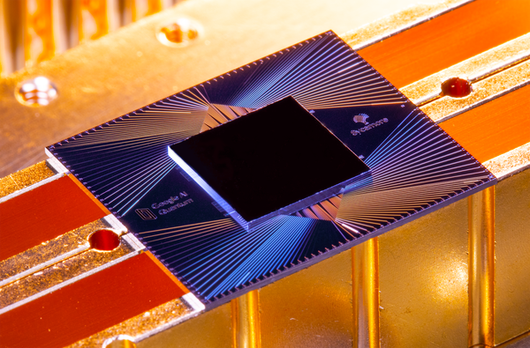
Quantum Supremacy

Slide 18
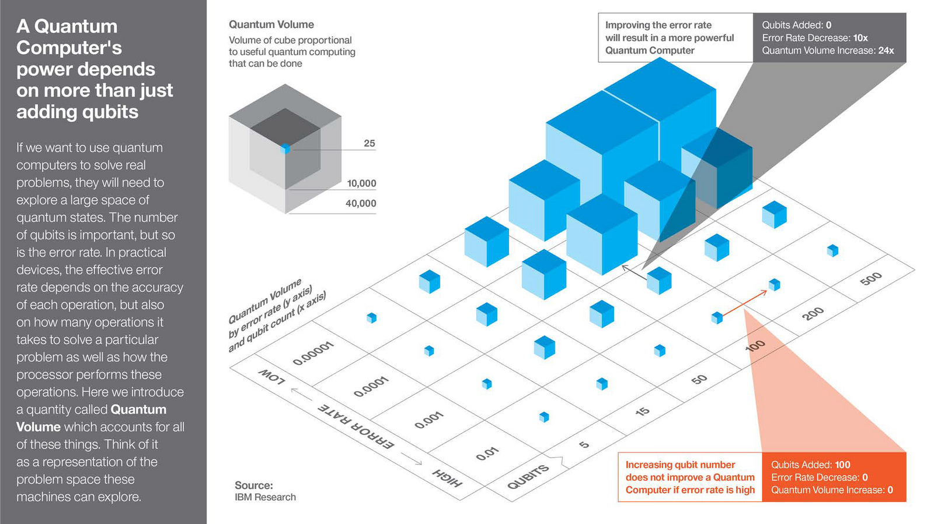

Slide 19

Applications
Notes:
https://i2.wp.com/syncedreview.com/wp-content/uploads/2018/04/advancing-drug-discovery-through-academicindustry-collaboration-294698.png

Slide 20
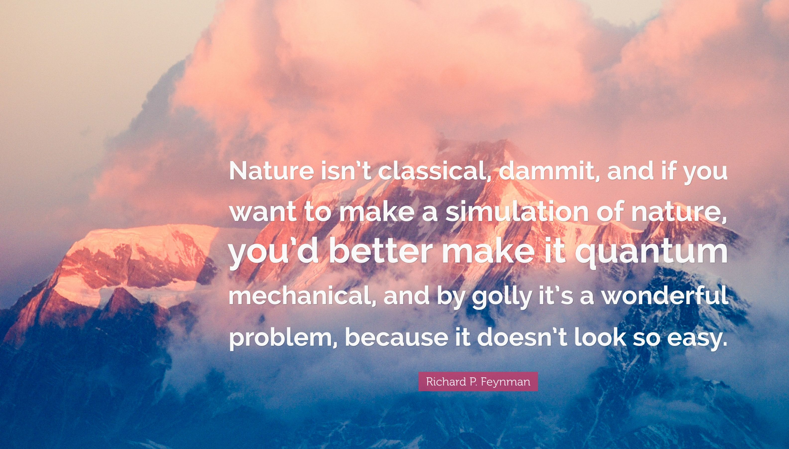

Slide 21

Simulating Quantum Phenomena
Direct mapping between molecular wave functions and qubits
Number of gates scales polynomially with system size
Quantum Chemistry applications: simulating molecules

Slide 22

(Post) Quantum Cryptography
Perfect quantum computers will break current classical cryptography techniques
Research avenues:
PQC: Modify existing protocols so that quantum computers cannot break them
QC: Setup new communications infrastructure which promises security based on quantum physics

Slide 23
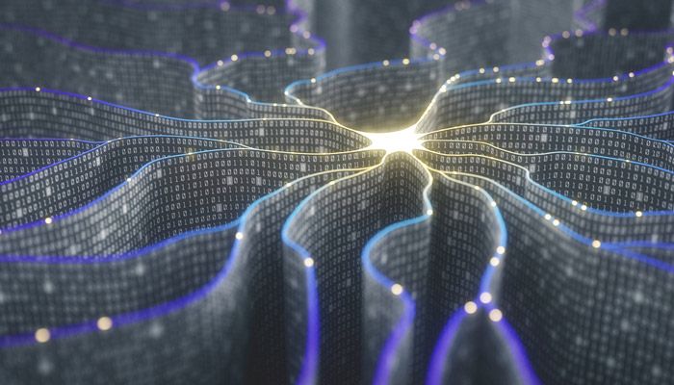
Optimization and Machine Learning
Hybrid quantum-classical algorithms for optimization
No significant exponential speedups yet
Developing research area, promising for a few specialized problems

Slide 24
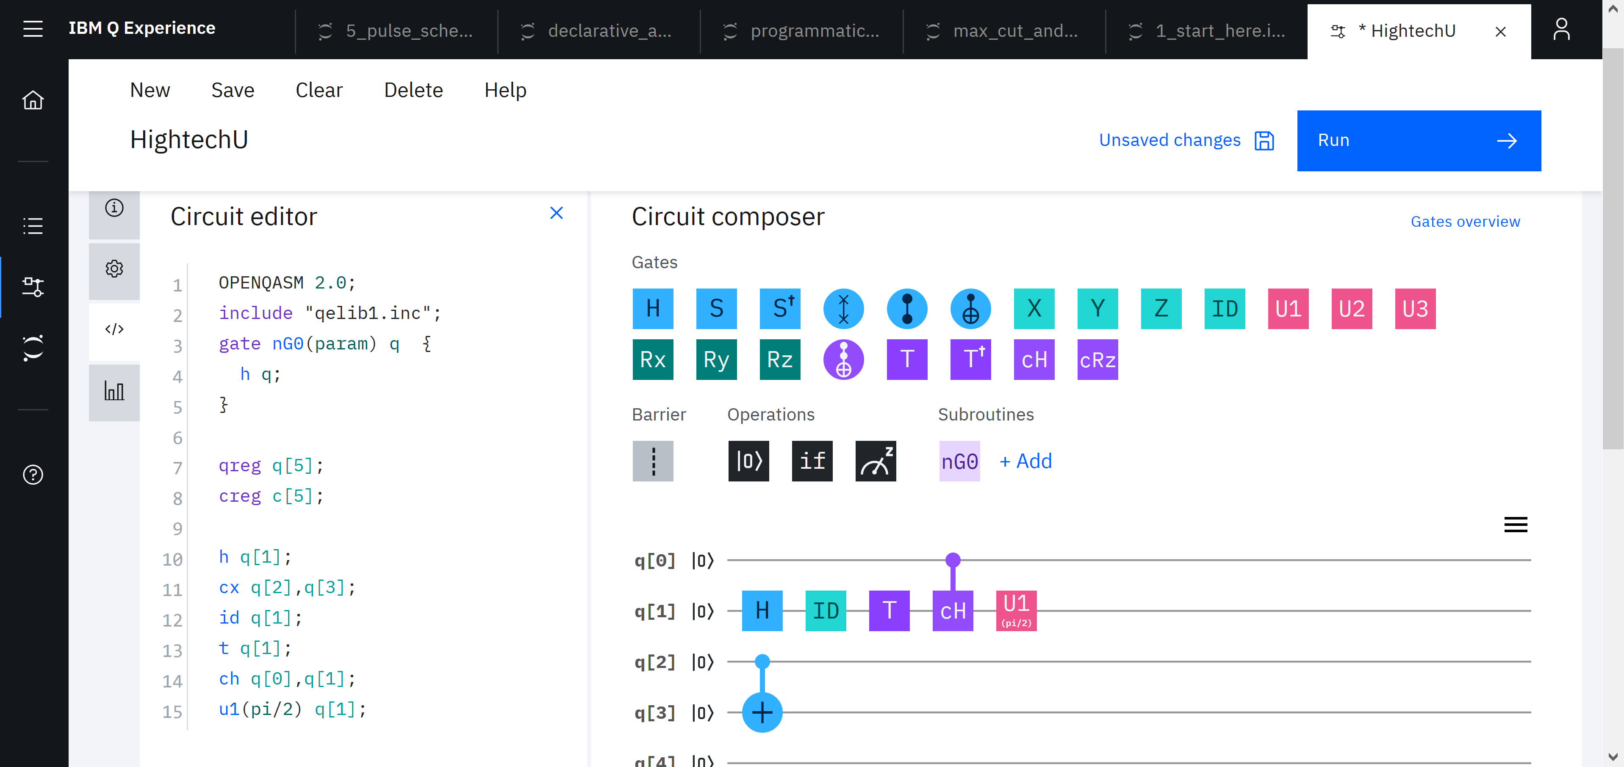
IBM Q Experience

Slide 25
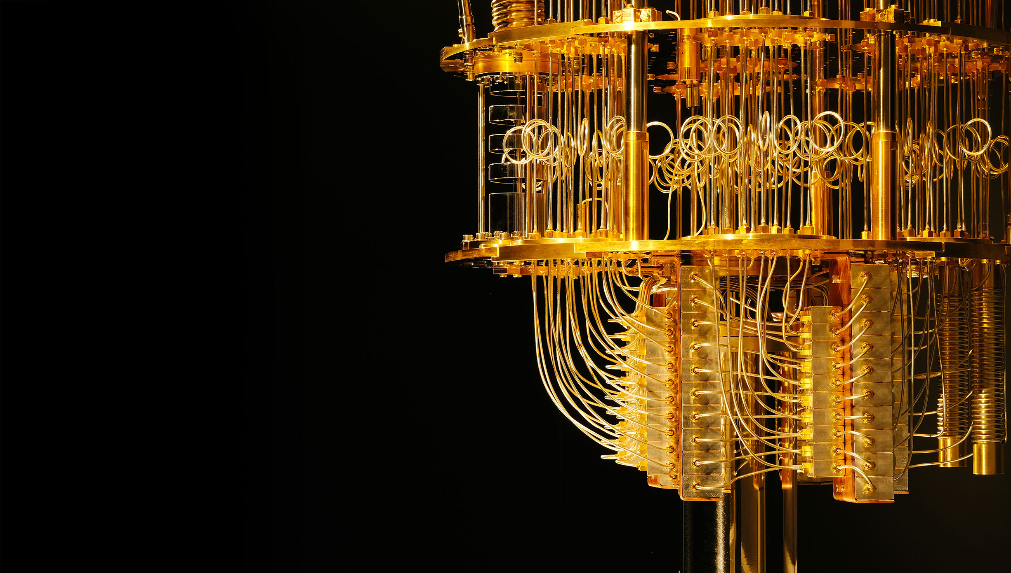
Quantum computing devices
https://quantum-computing.ibm.com/
Circuit Composer
https://quantum-computing.ibm.com/composer
Qiskit
https://qiskit.org/
Shtetl-Optimized
https://www.scottaaronson.com/blog/

Slide 26
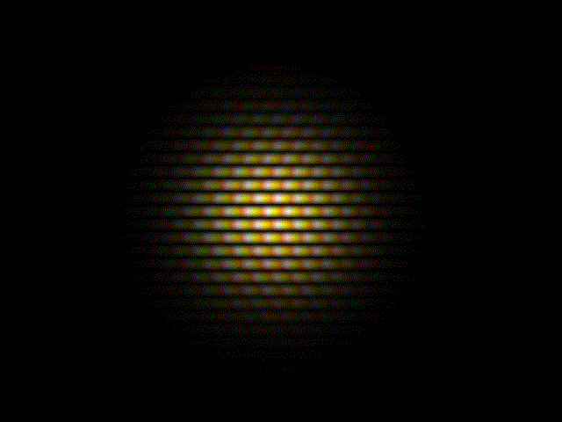
Thank You

Slide 27
Backup slides

Slide 28
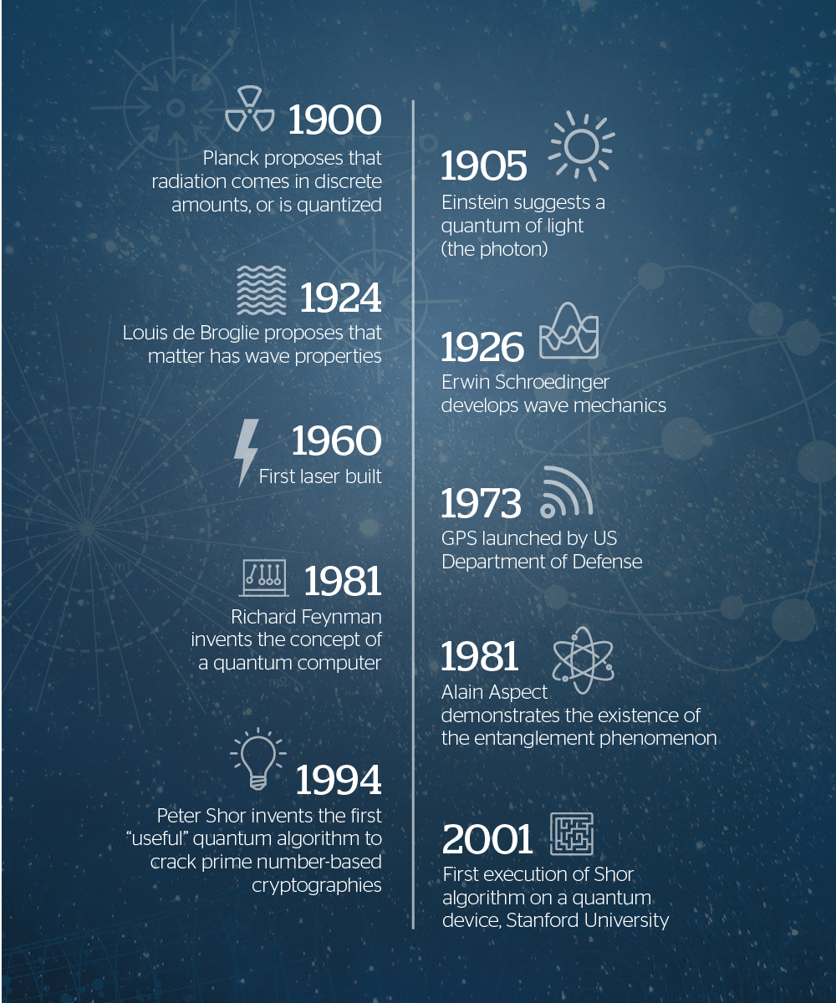
Timeline
Notes:
https://atos.net/en/insights-and-innovation/quantum-computing

Slide 29
